Slide 1
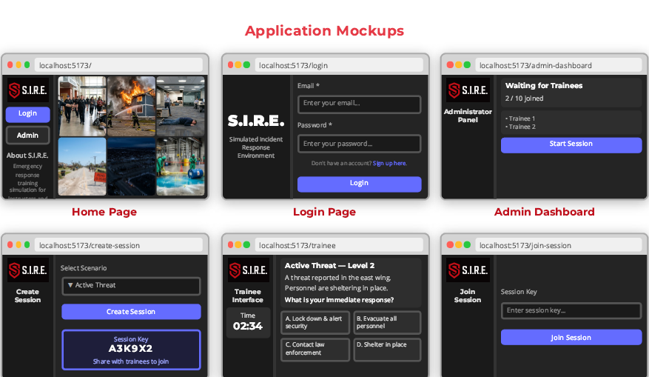

S.I.R.E. — Simulated Incident Response Environment
Team Nibble · NSCC · PROG 3300 — Integrated Projects for Programming · Instructor: Alfred Parkes
A real-time emergency response training platform
Features
Description
Real-time event broadcasting via WebSocket
Scenario loading with timed, auto-escalating injects
Admin controls — start, pause, escalate, end
Trainee decision and action submission
Branching scenario logic with severity levels
Session key generation (6-character codes)
Live progress monitoring for instructors
Feedback and post-exercise results display
Colour-coded severity indicators (info/warning/critical)
Multi-user rooms with automatic reconnection
A full-stack, real-time simulation platform for practicing emergency response scenarios. Built with Node.js, Express, Socket.IO, and React, SIRE enables instructors to run dynamic, escalating incident simulations while trainees respond in real time.
Architecture (ERD)
SWOT
Instructor Admin Dashboard
⬦
Trainees React UI (×10+)
Strengths
Real-time WebSocket; full-stack JS; modular scenarios; session isolation; no DB dependency
Weaknesses
In-memory storage (no restart persistence); no persistent accounts; WAN latency risk
↕ WebSocket / HTTP
Opportunities
Persistent session logs; mobile-responsive client; expanded scenario library; LMS integration
Threats
Free-tier cold-starts; browser WebSocket restrictions; server restart clears active sessions
⚡ Socket.IO Server · Express REST API · Node.js 20
↕
In-Memory Session Store
Escalation Engine
Scenario Registry (8)
Technology Stack
Scope
Rooms isolate sessions · Events broadcast to all participants · Automatic timeline progression
FRONTEND
Full-stack JS web application
Admin dashboard + trainee interface
Real-time WebSocket communication
Eight complete emergency scenarios
Session-based access (admin/trainee)
Free-tier cloud deployment
Documentation + testing artefacts
Training Scenarios
React 19
React Router 7
Vite 7
Socket.IO Client 4
BACKEND
Active Threat
Lockdown, sweep, all-clear procedures
Fire Emergency
Alarm, evacuation, fire dept. handover
Node.js 20
Express 4
Socket.IO 4
ES Modules
Nanoid
REAL-TIME
Flood
Water intrusion, system protection
Cyber Attack
Ransomware, network isolation, IR
WebSocket
Long-Poll Fallback
Room Isolation
Auto-Reconnect
DEVOPS & DEPLOYMENT
Power Outage
UPS/generator failover, critical systems
Severe Weather
Shelter-in-place, facility protection
Docker (Alpine)
GitHub Actions CI
Railway
Render
Heroku
Medical Emergency
Cardiac event, first-aid, EMS coord.
Hazmat Spill
Containment, PPE, decontamination
Key Metrics
Roles
8
10+
TB
Backend & Real-Time Lead
Tom Burchell
Socket.IO engine · scenario logic · server architecture · CI/CD · cloud deployment
Application Mockups
SCENARIOS
TRAINEES/SESSION
Home Page
S.I.R.E. landing · scenario overview
Login Page
Email / password · role select
Admin Dashboard
Session key · inject controls
<300ms
12
EVENT LATENCY
WEEKS DEVELOPMENT
Trainee Interface
Live events · action submission
Create Session
Scenario select · start session
Join Session
6-char code · trainee onboarding
LW
Frontend & UI/UX Lead
Leon Wasiliew
React UI · layouts · real-time state updates · responsive design
JH
Script Master / QA
John Hay
Scenario writing · integration testing · accessibility review
SCAN TO EXPLORE
KP
Project Manager
Kael Payette
Coordination · documentation · Git workflow · standards
S.I.R.E. — Simulated Incident Response Environment
NSCC · PROG 3300 Integrated Projects for Programming · Instructor: Alfred Parkes | Team: Tom Burchell · Leon Wasiliew · John Hay · Kael Payette
Scenario images: Gemini
Node.js 20
React 19
Socket.IO 4
Docker

